Slide 1
The effects of Covid-19 on air transportation
ebay-espresso
Conor Aitken, Damini Patel, Diane Yaneza,
Faisal Mali, Jayne Horton, Mwansa Mwango

Slide 2
Hypothesis and Questions
Our expectation was that air travel by passengers would be substantially reduced by restrictions on travel, and that airlines would find alternate ways to maintain maximum usage of planes.
Which countries were planes coming into Australia from?
What were the numbers of passengers arriving to and departing from Australia?
What was the amount of freight and mail in and out of Australia?
What were the ratios of passengers to freight per flight?
Did any airlines stop servicing Australia in 2020?

Slide 3
Data
We wanted to use ten years of historical data to show prior pattens
Origin and destinations of all flights
Passengers, freight and mail volumes
Each of these over a 10 year period
Bureau of Infrastructure and Transport - two data files

Slide 4

Exploration & Cleaning
Explored a few options before settling on air traffic as finding data was challenging for some of the topics considered
Considered exploring the financial implications however international figures were unavailable
Files contained airline information in one and volumes of passengers, freight & mail in another
CSV files were set as ‘Human readable’ for excel use – cleaning involved removing dead space to make the files usable for pandas
Numeric data needed to be converted from strings to floats

Slide 5

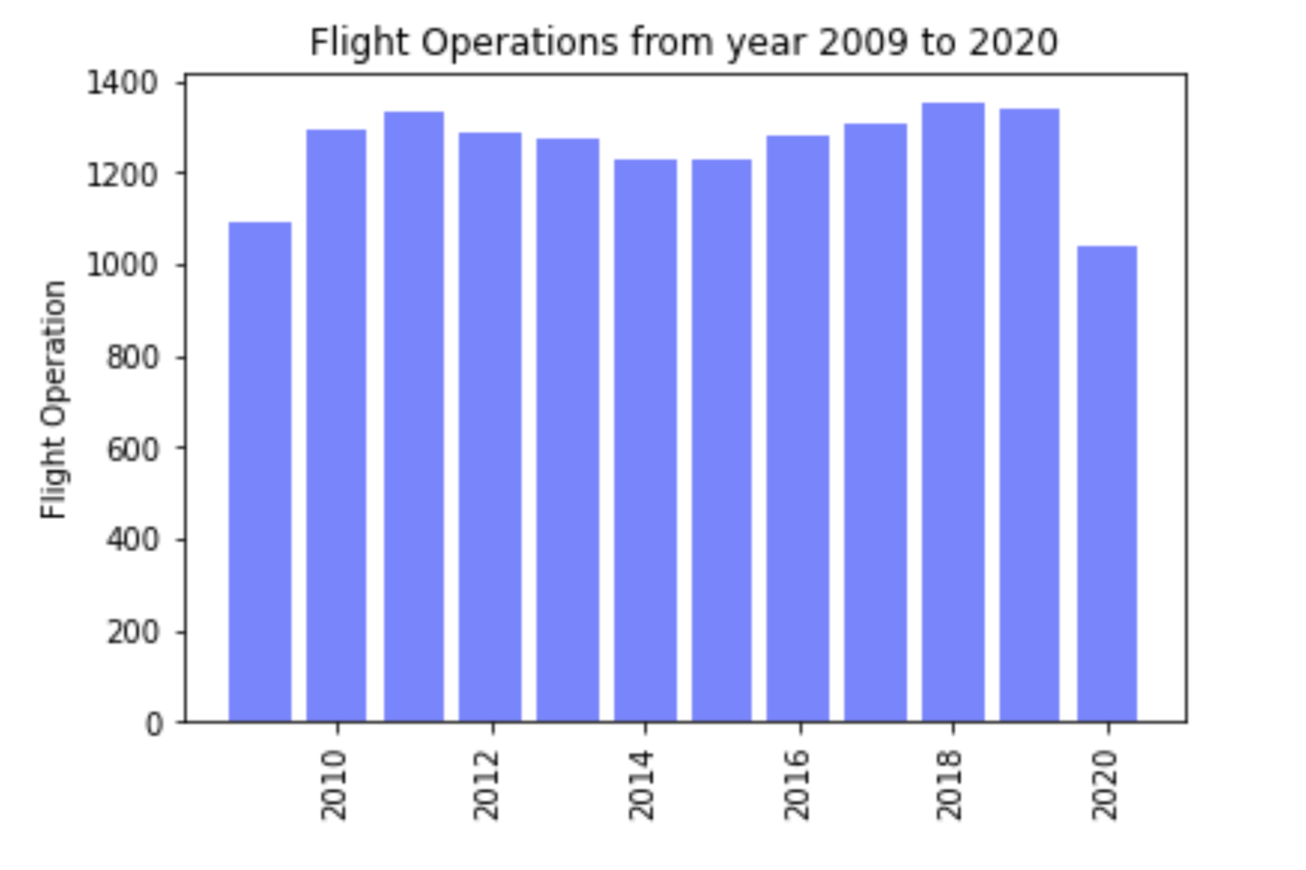

Which countries were planes coming into Australia from?
???

Slide 6
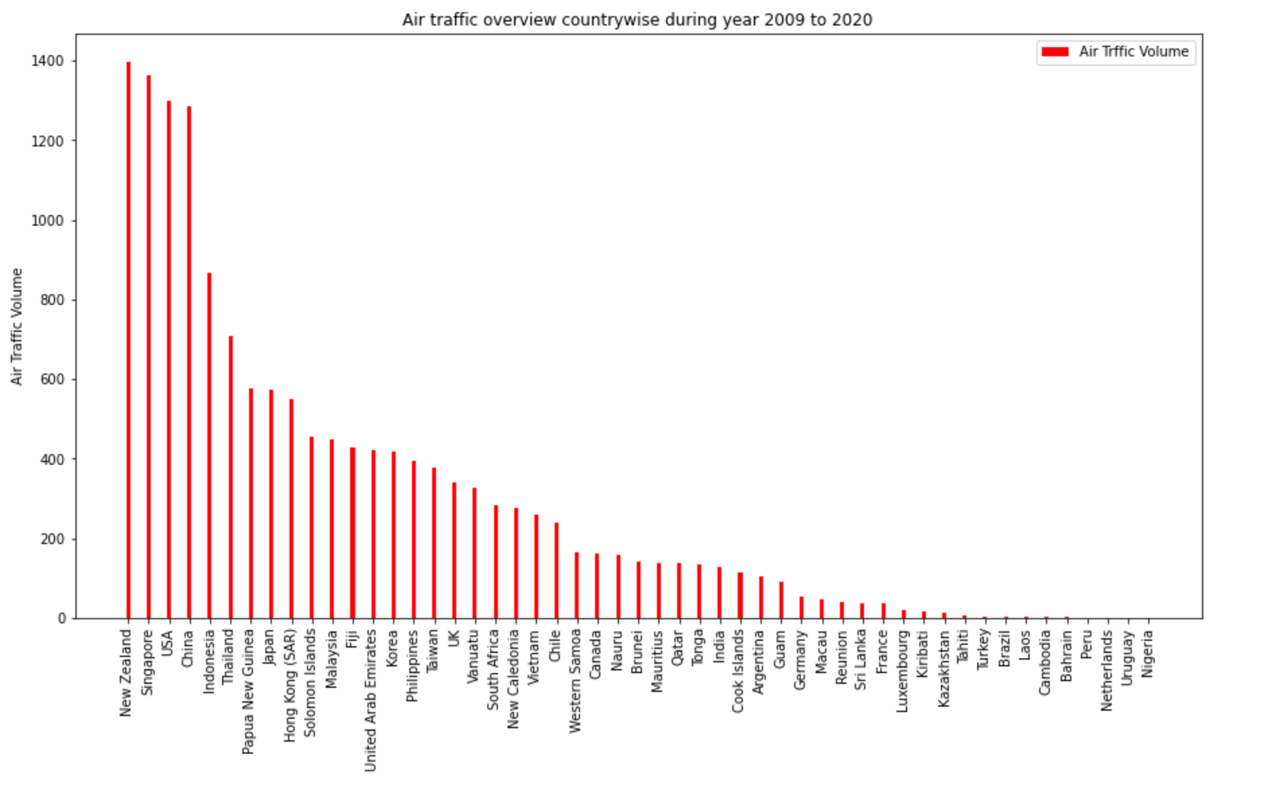
Air Traffic Volume from 2009 to 2019

Slide 7
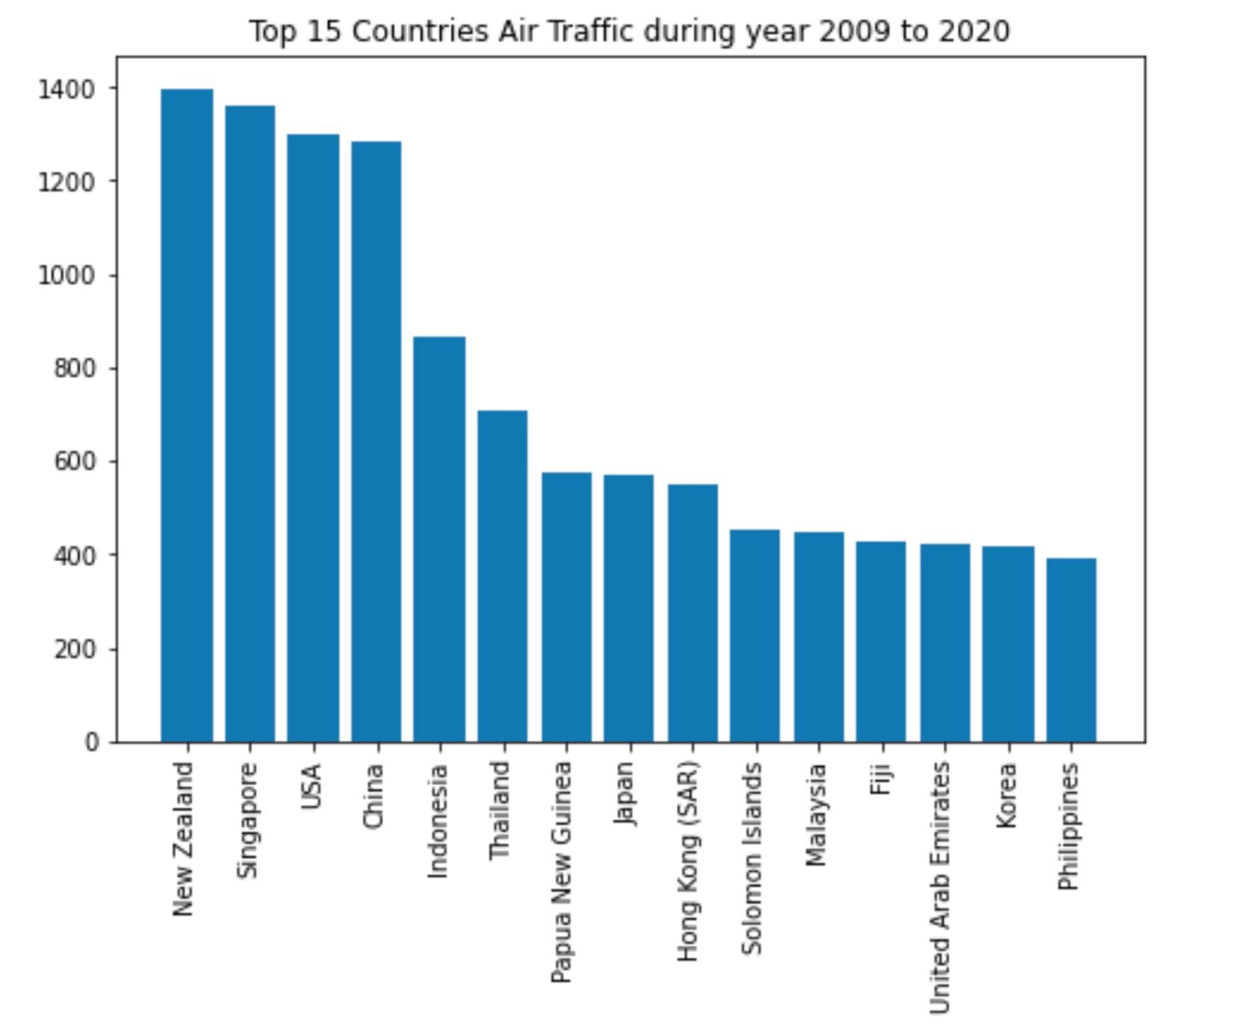
Countries with Highest Volume of Traffic 2009 to 2020

Slide 8
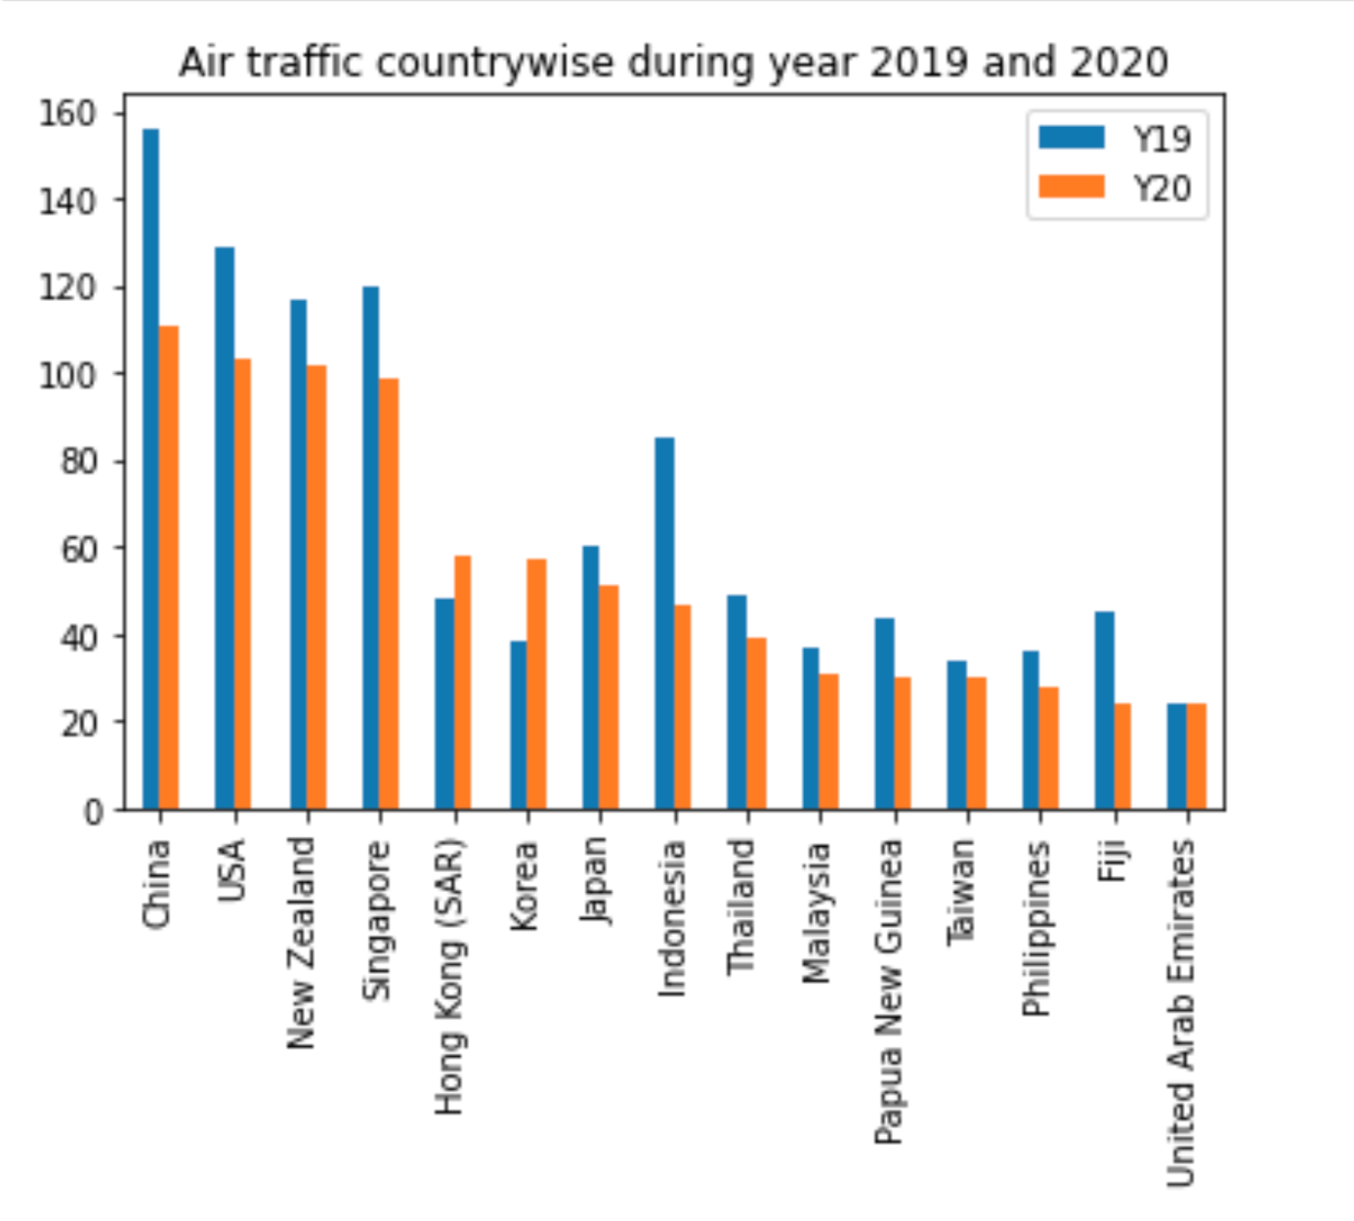
Air Traffic During 2019 & 2020

Slide 9
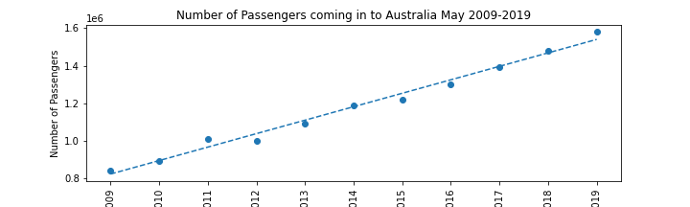
Passengers In

Slide 10
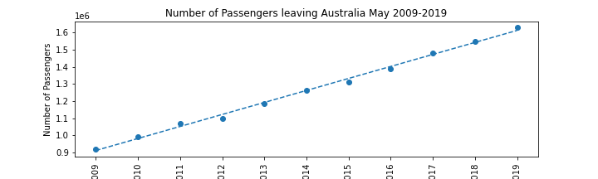
Passengers Out

Slide 11
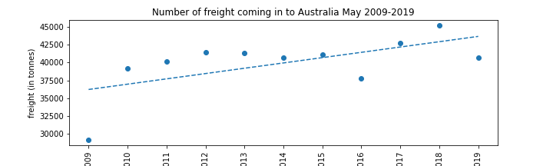
Freight In

Slide 12
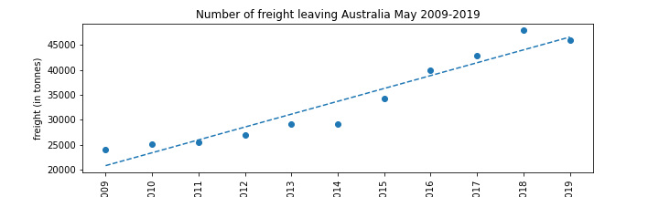
Freight Out

Slide 13
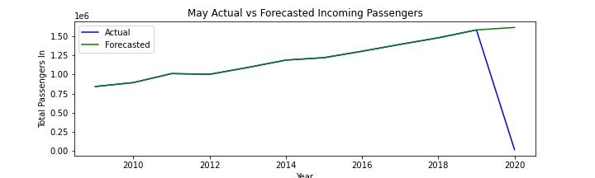
Passengers In Projected

Slide 14
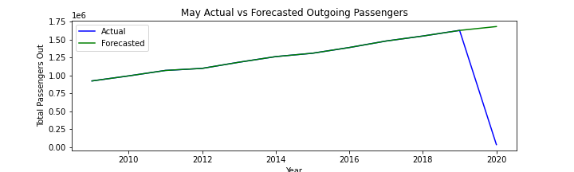
Passengers Out Projected

Slide 15
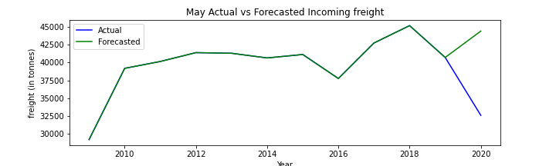
Freight In Projected

Slide 16
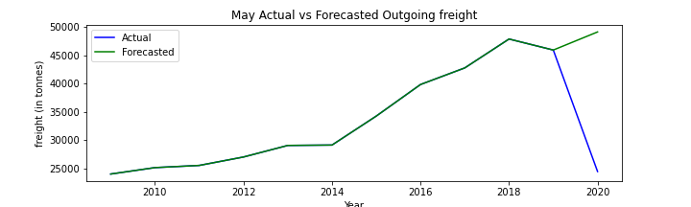
Freight Out Projected

Slide 17
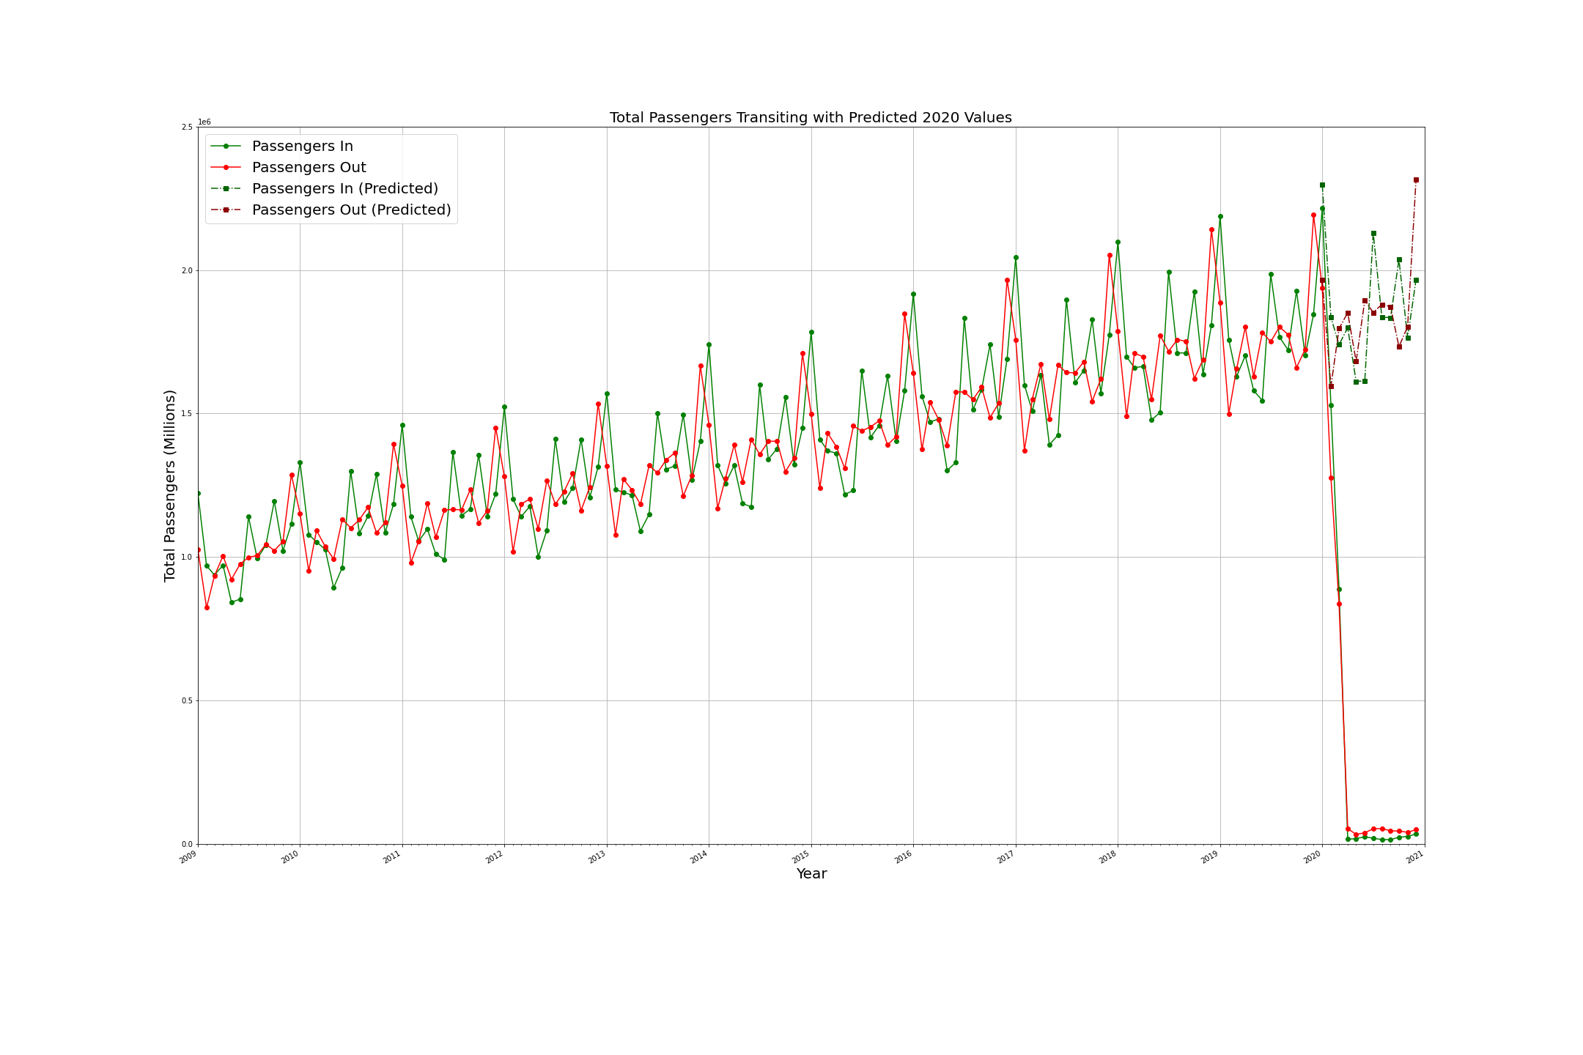
Total Passengers Predicted versus Actual

Slide 18
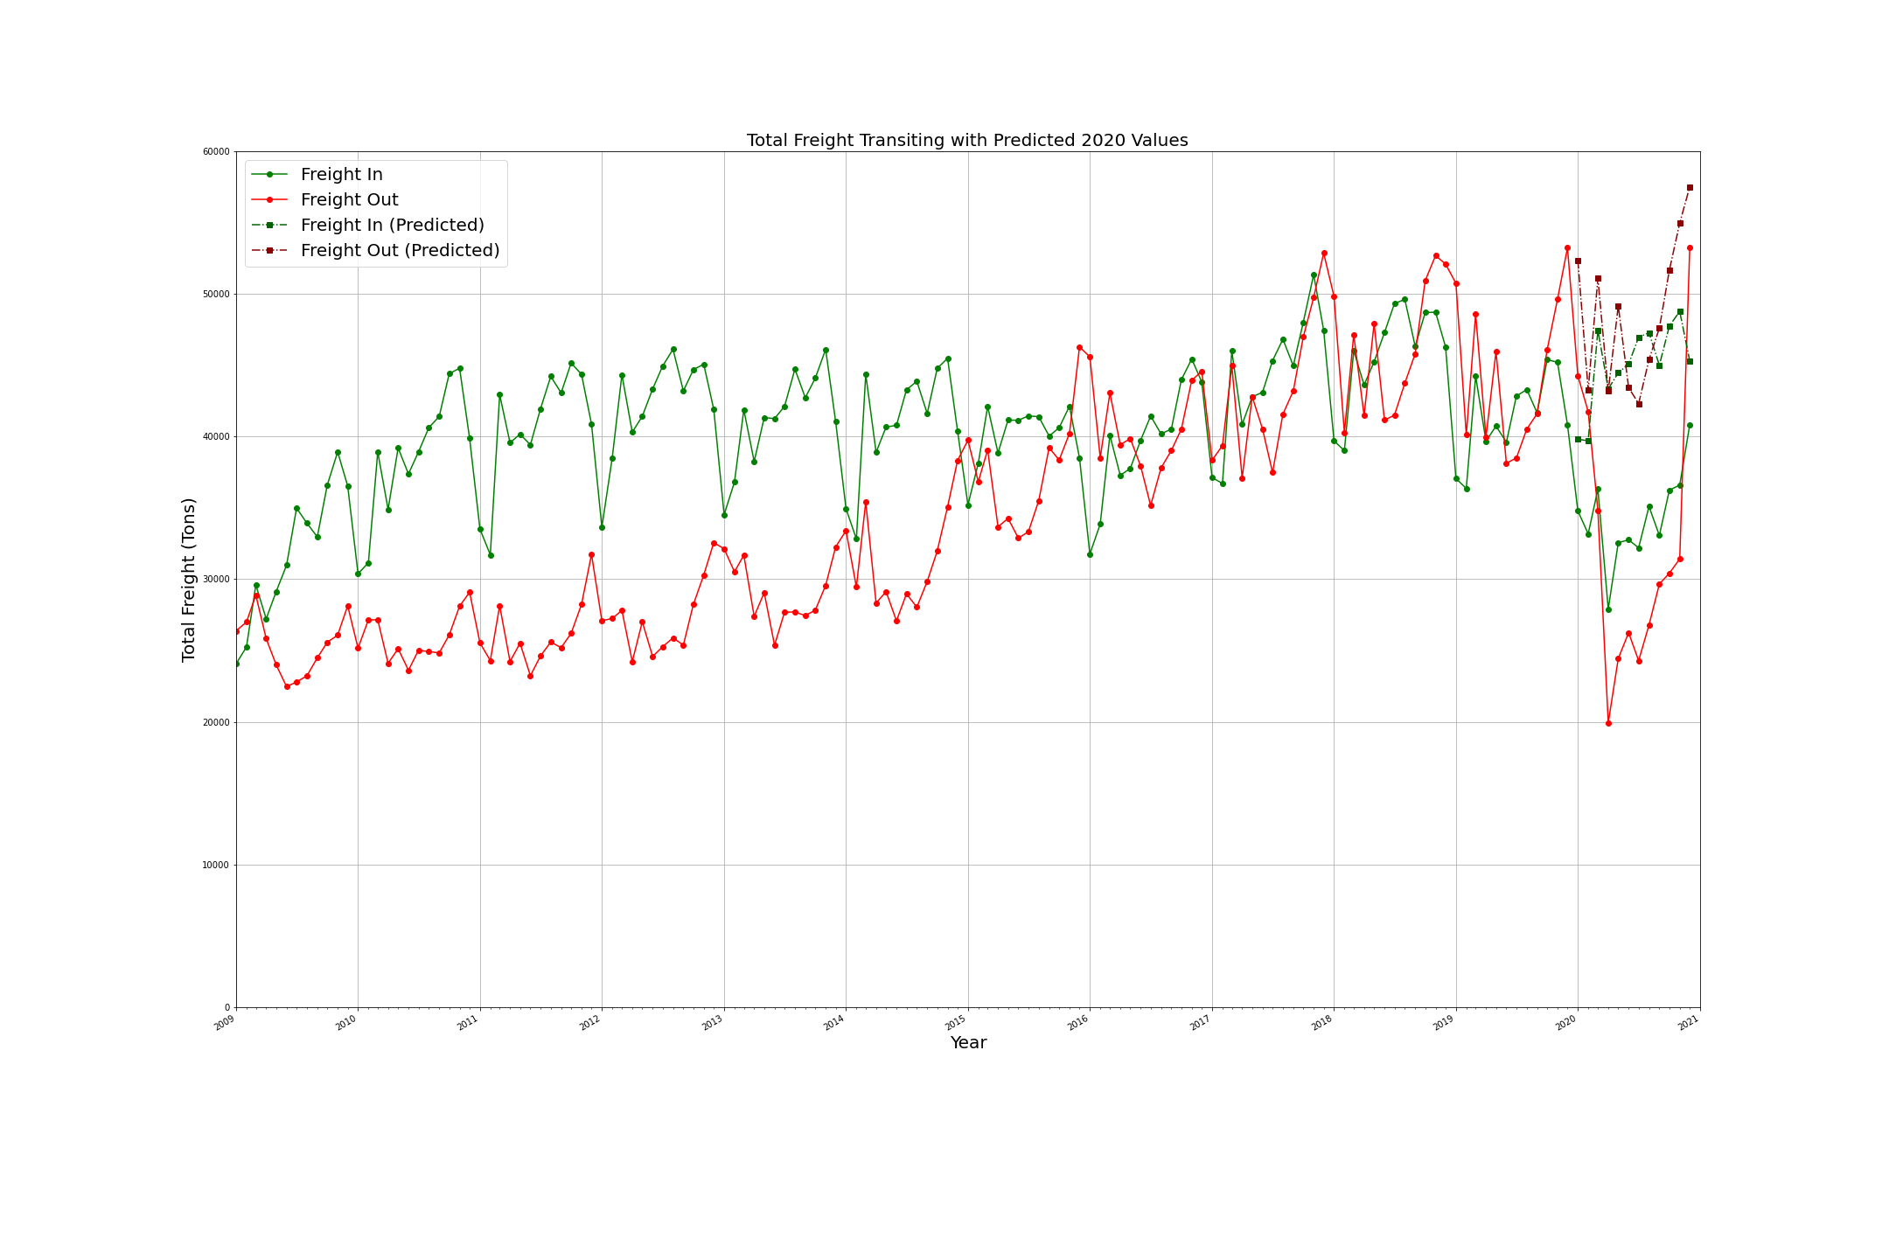
Total Freight Predicted versus Actual

Slide 19
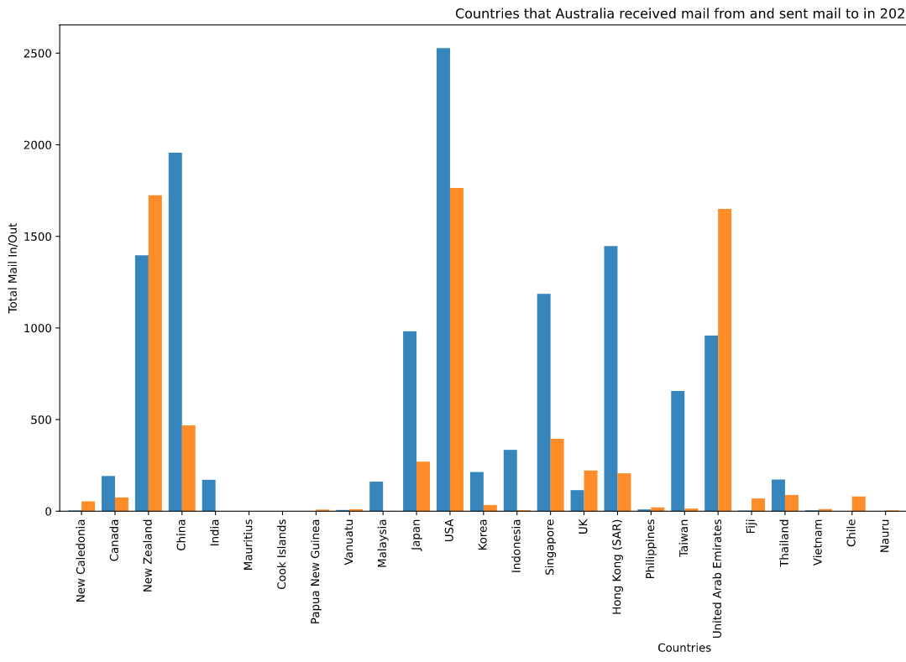
Origin Countries for Mail

Slide 20
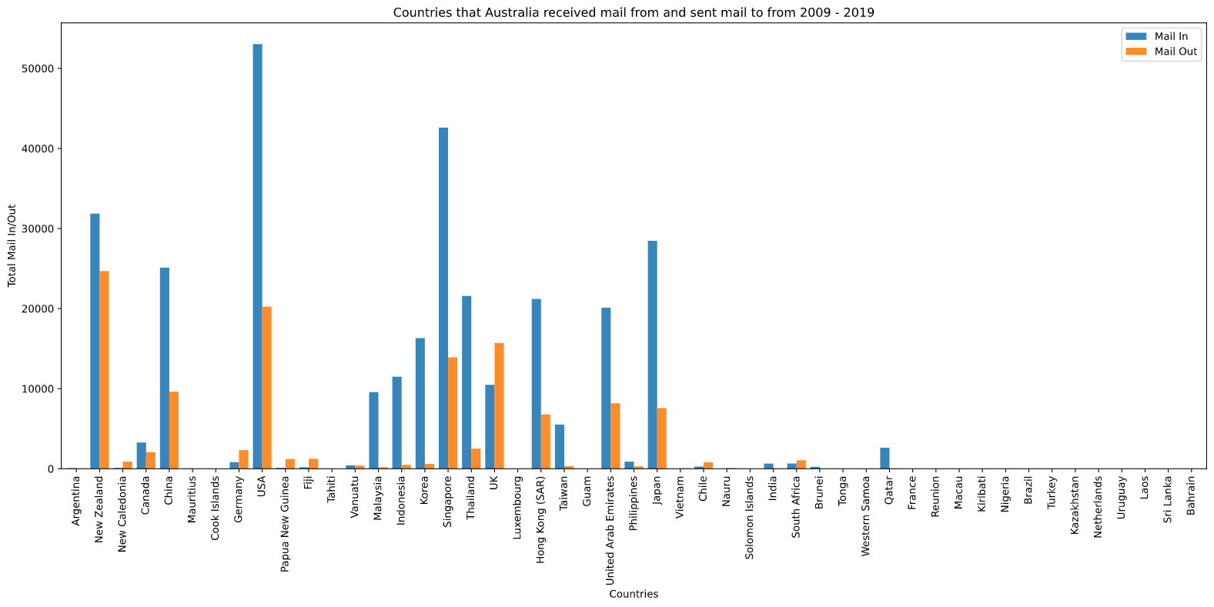

Slide 21
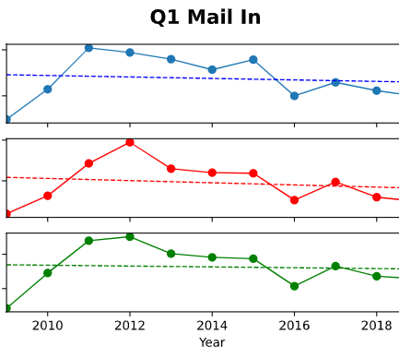
Linear Regression to Predict 2020 for Mail In

Slide 22
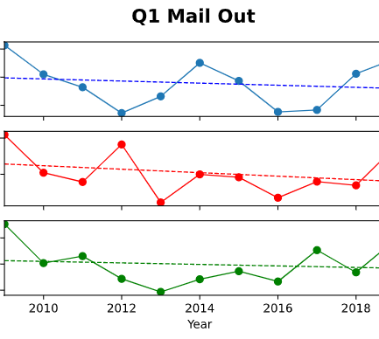
Linear Regression to Predict 2020 for Mail Out

Slide 23
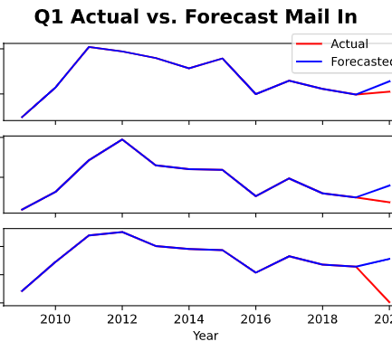
Forecast Mail In

Slide 24
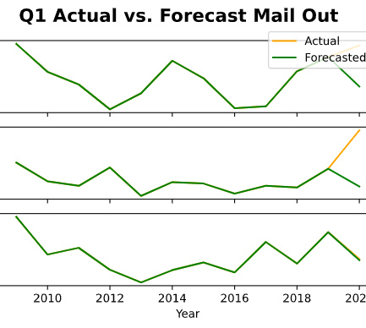
Forecast Mail Out

Slide 25
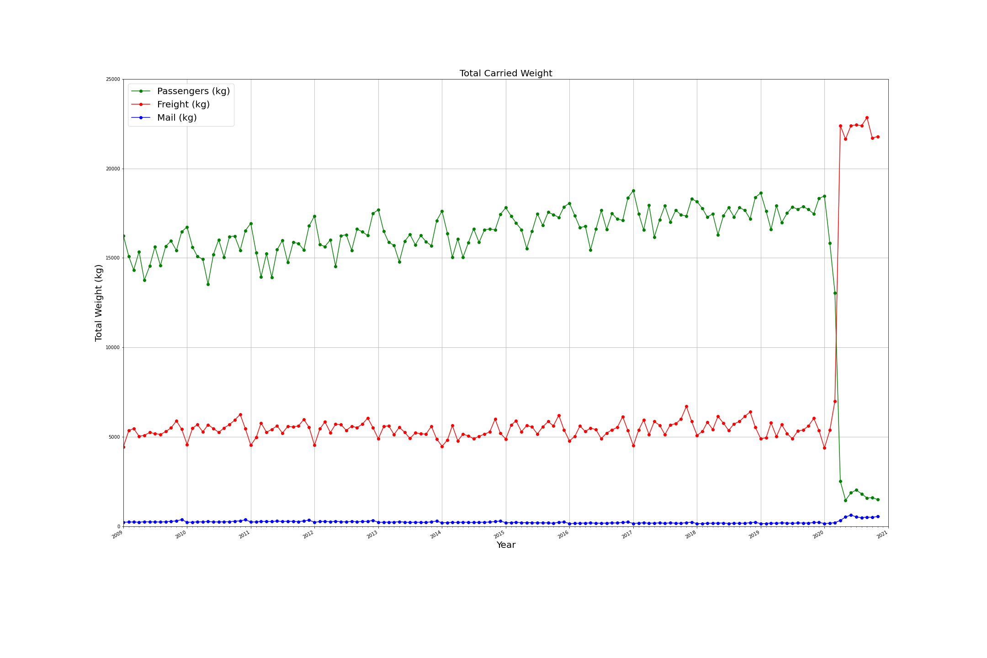
Ratios of Passengers to Freight and Mail

Slide 26
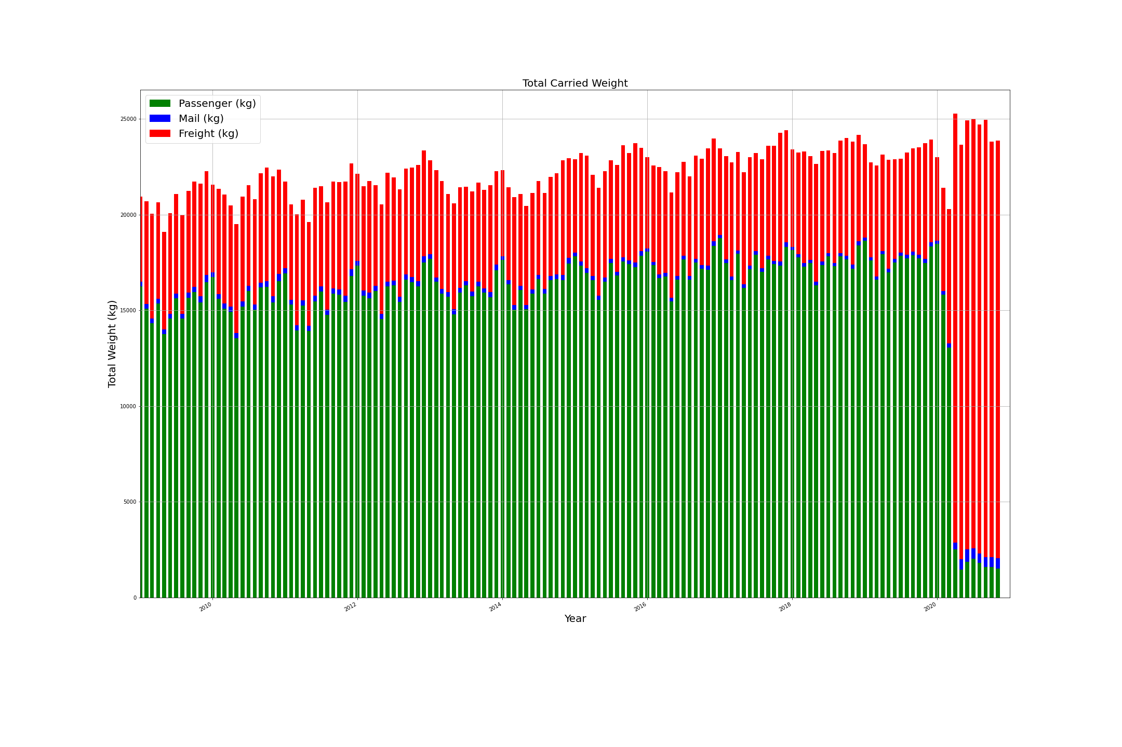

Slide 27
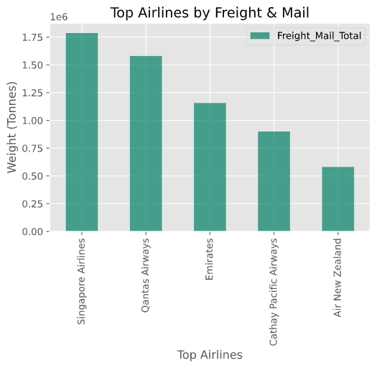
Airlines Servicing Australia

Slide 28
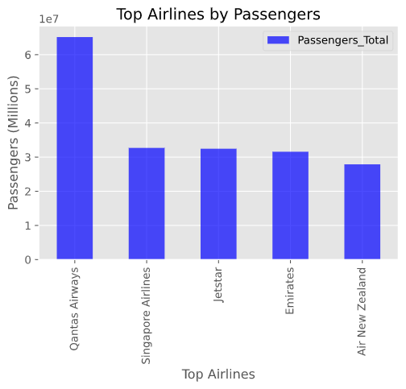
Passenger Totals by Airline

Slide 29
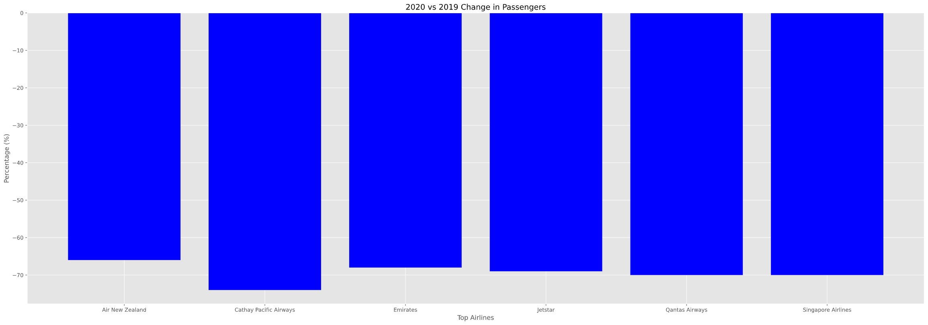
Changes in Passengers 2019 - 2020

Slide 30
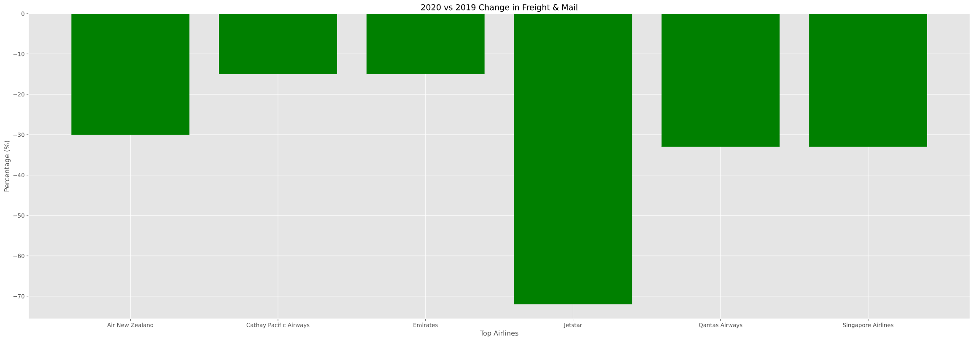
Changes in Cargo 2019 to 2020

Slide 31
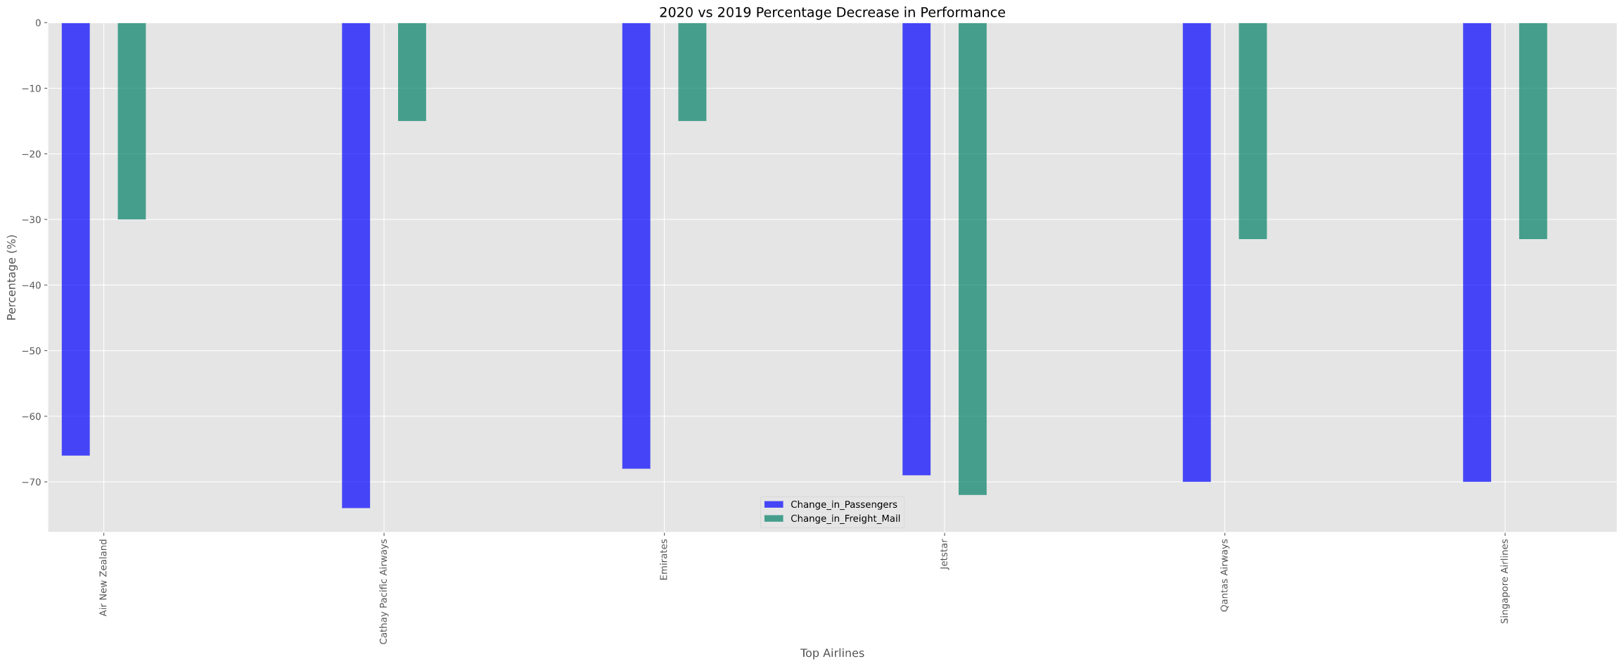
Changes in Passengers and Cargo 2019 - 2020

Slide 32
Conclusions
Additional questions we would have explored with more time?

